Slide 1


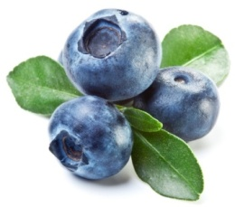
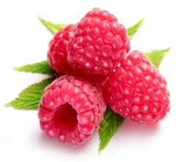
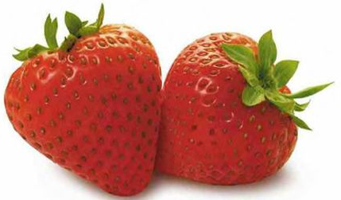
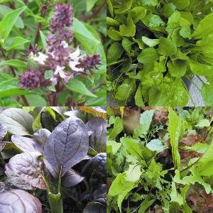

Antimicrobial efficacy gaseous ozone
on berries and baby leaf vegetables
Silvia de Candia¹,T. Yaseen², A. Monteverde¹, C. Carboni³ and F. Baruzzi¹
¹Institute of Sciences of Food Production, National Research Council of Italy, V. G. Amendola 122/O, 70126 Bari, Italy
²CIHEAM/Mediterranean Agronomic Institute of Bari, Via Ceglie, 9, 70010 Valenzano (BA), Italy
³De Nora NEXT-Industrie De Nora S.p.A. Via Bistolfi, 35- 20134 Milan, Italy
Notes:
Dear Chairman,
Firstlt I thank you for inviting me to speack about our results of: Antimicrobial efficacy gaseous ozone on berries and baby leaf vegetables

Slide 2

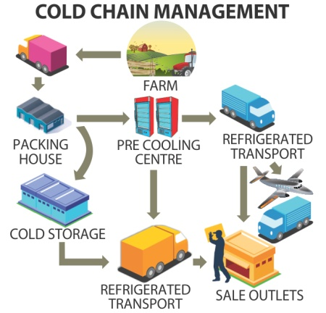

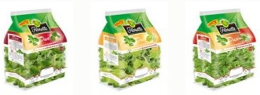

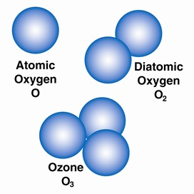
Typical Cold Chain
Safe foods
Fresh foods
Raw foods
Notes:
Consumers require safe, fresh and ready to eat food.
In order to extend the shelf life post harvest vegetables and fruits, conventionally processes include the application of low temperature. The typical cold chain as represented in the figure, does not represent an appropriate way to ensure food quality and especially to keep it stable with time.
Therefore, new advanced methods of preservation include the use of ozone that doesent release residue, and then the food is safe.
Ozone an unstable highly reactive molecule composed by three oxygen atoms (O₃)

Slide 3

under gaseous form
water-solube form
DISPLAYS
oxidative capacity against proteins, lipids, enzymes, nucleic acids, membranes and other cellular constituents
Wide range of antimicrobial activity
thanks its
O₃ gaseous |  | O₃ water-solubilized
T (°C) | Halflife (days) | T (°C) | Halflife (min)
-50 | 90 | 15 | 30
-35 | 18 | 20 | 20
-25 | 8 | 25 | 15
20 | 3 | 30 | 12
120 | 0.7 | 35 | 8
O₃ is relatively stable in the gaseous state, while much more unstable in aqueous solution where it quickly degrades in oxygen (Miller et al., 2013).
Miller F.A., et al. 2013. Food Engineering Review. 5, 77.
Notes:
Immediately after production ozone can be applied under gaseous or water-solube form
Ozone displays a wide range of antimicrobial activity thanks to its oxidative capacity against proteins, lipids, enzymes, nucleic acids, membranes and other cellular constituents.
Ozone is relatively stable in the gaseous state, while much more unstable in aqueous solution where it quickly degrades in oxygen, as shown in the table. Although ozone is highly soluble in water (580 mg / L at 27 ° C), its rate of solubility depends on numerous factors, such as pressure, temperature, pH, size of the bubbles of ozone, the ozone flow rate and contact time , water purity, etc. .; high temperature, high pH, the presence of mineral and organic substance cause a more rapid decomposition of ozone (decrease of halflife).

Slide 4

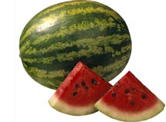
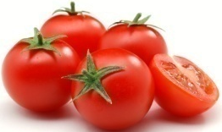
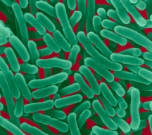
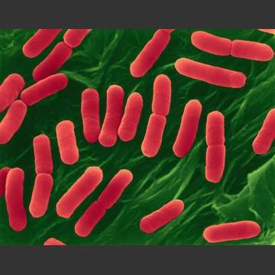
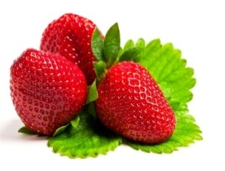
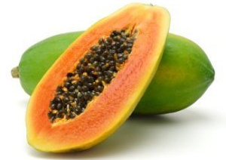
Fresh-cut fruits and vegetables have been recentely traced as responsible for human outbreaks depending by low quality of water used for washing and chilling the produce after harvest is critical (Gil et al., 2009).
Ozone treatments have been recently evaluated useful in improving safety of both water bodies and vegetables.
Artificially inoculated seeds of lettuce, water melon and tomato (Trinetta et al., 2011) reduced Salmonella enterica and E. coli O157: H7 population of about 2 log CFU/g.
The treatment with gaseous (Han et al., 2002) showed the influence of ozone concentration, RH and extension of treatment periods in killing E. coli O157:H7 contaminating green peppers.
Despite good results in controlling foodborne pathogens, ozone treated vegetables showed chlorophyll degradation and weaking of colour occurred (Wang et al., 2004) together with an increase in oxidative stress and senescence of vegetable tissues (Aguayo et al., 2006; Goncalves, 2009).
Salmonella enterica
E. coli O157: H7
However, ozone treatments failed in reducing total mesophilic bacteria natural occurring in strawberries (Allende et al., 2007) or on fresh-cut papaya (Yeoh et al., 2014).
Allende et al., 2007. Postharvest Biology and Technology, 46(3), 201; Aguayo et al., 2006 Postharvest Biol. Technol. 39, 169; Gil et al., 2009. International Journal of Food Microbiology, 134, 37; Goncalves, 2009. Archivies of Biology and Technology 52, 1527; Trinetta et al., 2011. International journal of food microbiology, 146(2), 203;Yeoh et al., 2014. Postharvest Biology and Technology, 89, 56; Wang et al., 2004 . Food Research International ,37, 949;.
Notes:
Many study report the use of ozone to preserve or extend the shelf life post harvest.
We note that some tratment with ozone have efficacy against food patogenes bacteria, on the other cases treatment failed. In base of this results, we can not predicted the efficay of ozone tretment, only because sometimes ozone has an antimicrobial effect so occurse evaluate the efficacy case by case.
Fresh-cut fruits and vegetables have been recentely traced as responsible for human outbreaks depending on low quality of water used for washing and chilling the produce after harvest is critical.
Ozone treatments have been recently evaluated useful in improving safety of both water bodies and vegetables like lettuce, tomato.
Trinetta et al., artificially inoculated seeds of lettuce, water melon and tomato reduced Salmonella enterica and E. coli O157: H7 population of about 2 log CFU/g (per grams).
Han et al., 2002, described the treatment with gaseous, that showed the influence of ozone concentration, RH and extension of treatment periods in killing E. coli O157:H7 (or patogenic strain) contaminating of green peppers.
Despite good results in controlling foodborne pathogens, ozone treated vegetables showed chlorophyll degradation and weaking of colour occurred together with an increase in oxidative stress and senescence of vegetable tissues. However, ozone treatments failed in reducing total mesophilic bacteria naturally occurring in strawberries or on fresh-cut papaya.

Slide 5
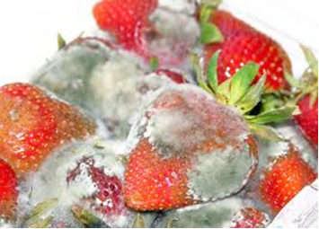
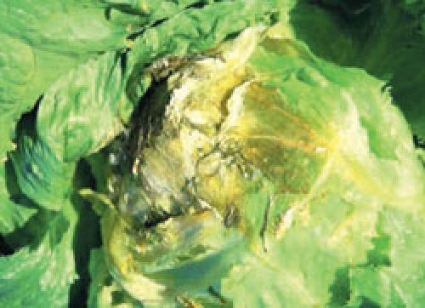
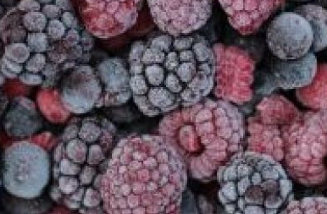
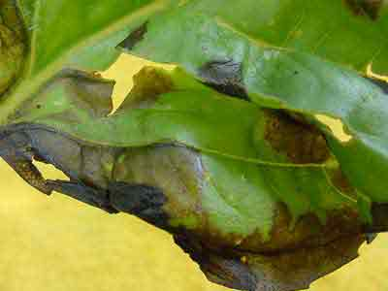
Erwinia spp.
Pseudomonas spp.
Pectinolytic and Proteolytic activities as low temperature
Fungal contamination after harvest can blunt their beneficial effects and can lead to the loss of a large percentage of yeald
The advanced oxidation processes (AOPs)
represent the newest development in sanitizing technology (Selma et al., 2008).
Selma et al., 2008. Food Microbiology, 25, 809
Notes:
In the last few years, following the consumers’ demand for RTE foods, fruits and vegetables are usually manipulated, processed and cold stored for some days before being ready for consumption.
Ready-to-eat (RTE) vegetables are fresh products with limited shelf-life, that need to be stored under refrigeration conditions. Erwinia spp. and Pseudomonas spp. represent the main spoilage microflora, which contribute to soft rot on RTE vegetables, attributed to the their pectinolytic and proteolytic activities that can be also active at temperatures as low as 0-2 °C. The ability of these microorganisms to grow and release enzymes at low temperature accentuate the decay quality of RTE vegetables under cold storage. Differently berryfuits are contaminated by fungi that reduce shelf life and reduce their benefical effects.
The advanced oxidation processes (AOPs) represent the newest development in sanitizing technology, where more oxidants are used simultaneously.
Thus, in comparison with fresh fruits and vegetables, RTE produce lead to a new matter of safety concerns with a greater frequency of foodborne illnesses.
In both cases the shelf life period reduced by the occurence of spoilage microrganisms such as Erwinia and Pseudomonas in leaf while for berries are fungi.

Slide 6
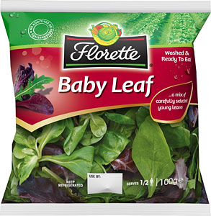
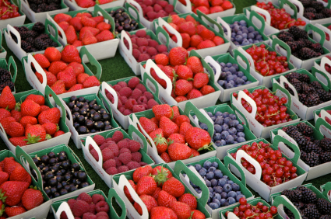
Aim of this work
was to evaluate the suitability of gaseous ozone treatments in controlling spoilage microorganisms (fungi and bacteria) contaminating ready-to-eat vegetables (berries and baby leaf).
Notes:
We approce the problem with 2 different cases: baby leaf and berries fruits
The aim of this work was to evaluate the suitability of gaseous ozone treatments in controlling fungi and bacteria contaminating ready-to-eat vegetables.
The consumption of berries is encouraged due to the health benefits that derive from their high content of polyphenols and anthocyanins, consumers believe in their antioxidant, anticancer, anti-neurodegerative and anti-inflammatory properties. However, like many fruits, berries may often be contaminated by various microorganisms, and this can blunt their beneficial effects. In particular they are frequently contaminated by fungi and this can lead to the loss of a large percentage of harvest.
Among several studies conducted to find optimal postharvest technologies to preserve quality of these fruits, those describing ozone application showed promising results for different berries. Recently Bialka and Demirci, demonstrated the efficacy of both gaseous and aqueous ozone treatment in the reduction of viable cell count of Salmonella and E. coli O157:H7 populations inoculated on the surfaces of raspberries and blueberries, without affecting the nutritional properties of these fruits. High fruit marketability was also demonstrated when blueberries, treated with 700 ppb of gaseous ozone for four days, maintained their anthocyanin and phenolic compound content, without significant reduction in total antioxidant capacity.
In contrast with visual quality loss, strawberries exposed to ozone showed increase in the vitamin C content as well as ozoneated blackberries maintained their fresh colourduring storage thanks to a lower activity of peroxidase enzyme that is involved in fruit discoloration.

Slide 7
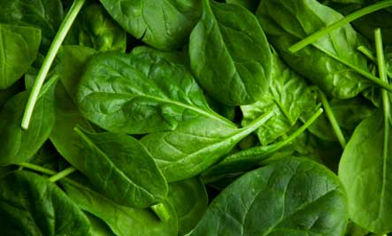
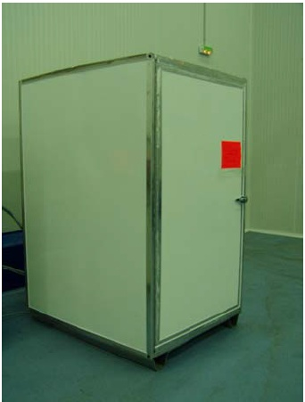
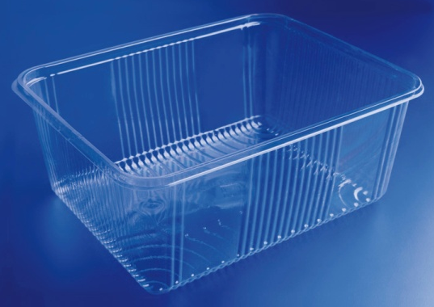
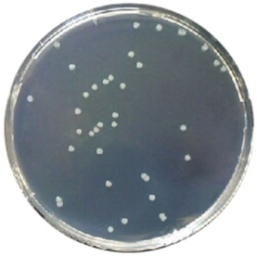
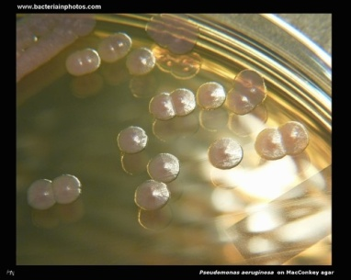
Baby leaves: scheme of treatment and analysis
Ozone generator O₃
continuous fumigation at 0.5 or 2 ppm.
Internal volume 3.3 m³, endowed with continuous air ventilation
7 days
T: 4/10°C
[O₃]: 0/0.5/2 ppm
t: 0, 3, 7 days
PCA
30°C, 48h
PSA
Notes:
The experimental scheme was:
vegetable samples homogeneous for type, weight and quality, were packed in trays of polypropylene and stored for 7 days in the refrigerator during which the vegetable material was subjected to two factors temperature (4 ° C and 10 ° C) and ozone concentration (0, 0.5 and 2 ppm). The concentration of 0.5 ppm of gaseous ozone was chosen with the aim of obtaining quantitative results in thresholds relatively harmless to the consumer.
PCA(total bacteria count) and PSA(mainly represent spoilage microrganisms) media were used or total bacterial count and the presumed bacteria belonging to the genus Pseudomonas.

Slide 8
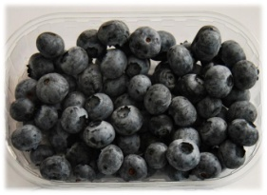

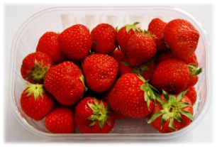
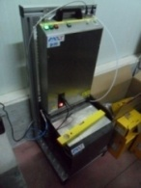
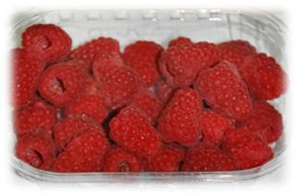
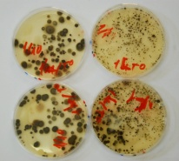
Berries: scheme of treatment and analysis
Ozone generator O₃
2ppm for 5min
or continuous fumigation at 0.3 ppm
4°C for 7 days
Antioxidant Enzymes
Spectrophotometrical anlysis
Anthocyanins
&
Flavonols
24°C, 72h
HPLC
NYDA
Notes:
Raspberries, strawberries and blueberries used in this study were harvested from commercial fields located in Pergine Valsugana (Trento). Gaseous Ozone was applied at 2 ppm for 5min (high concentration for short time), or with continuous fumigation at 0.3 ppm (at maild).
Treated and untreated fruit was preserved at 4°C for 7 days. To quantify colony forming units of 200g of fruits from each replicate , they were put in a beaker with 250 mL of sterilized distilled water and subjected to orbital shaking at 150 rpm for 1hr. CFUs were detected using the plate dilution method on NYDA medium after 3 days of incubation at 24°C. The activity of the considered antioxidant enzymes was analyzed spectrophotometrically (Kim et al. 2005) by using a Beckman DU 530 spectrophotometer. Anthocyanins and flavonols were extracted from fruit lyophilised samples, powdered by liquid nitrogen, and analyzed by HPLC following the method described by Nicoletti.
In addition to microbial evaluation some chemical analysis was evaluate: enzymatic activity and concentration of antioxidant anthocyanins and flavonols

Slide 9
Results

Slide 10
0.5ppm - 2ppm
Effect of O₃ on microbial population
of baby leaves
X
Notes:
Preliminary assays carried out at 2 ppm resulted in negative impact on leaves visual quality. Leaves lost their fresh green appearance.

Slide 11
Effect of O₃ on microbial population
of baby leaves
Total bacterial count
Pseudomonas spp.
10°C
4°C
Notes:
Ozone treatment produced different results depending on both target microorganism and ozoneated food
At 10 total microbial count increased in 7 days both in treatment with 0.5 ppm of ozone and untreated samples.
When we tested with low temperature, there wasn’t any variation of the effect only for spoilage micorganisms after seven days of treatment there was a light effect. This limitated impact on psychrophilic microflora of Pseudomonas at 4 ° C after 7 days that correspond at the end of shelf life.
If should be specified that a non determinable percentage of bacteria is located inside of the leaf blade, whereby these bacteria are protected from any disinfectant, including ozone, on the contrary to fungi.

Slide 12
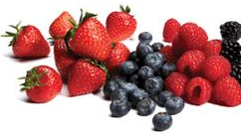
2 ppm 5 minutes – Ozone pulse 0.3 ppm 7days – Ozone continous
  Effect of O₃ on fungal contamination of raspberries, strawberries, and blueberries.
Notes:
On berries fruits, experiment followed with two concentration of ozone or with 2 different way: first case just single strong treatment and second light treatment during cold storage.

Slide 13
  Effect of O₃ on fungal contamination of raspberries, strawberries, and blueberries.
Notes:
On BB and RB, at first days we can see a natural reduction due to the low temperature of storage, partially improved by both ozone treatment. During storage untreated fruit showed a limited increase.
On strawberries, ozone caused a little good effect on reduce the fungal contaminants, during preservation as compared with untreated fruits, in both application mode 2 ppm for 5min or in continuous fumigation at 0.3 ppm.
The decrease of the cell concentration on the first day, was due to the temperature effect in addition to just a limited improvement caused by the effect of the ozone.
This shows that, at the tested conditions, the antimicrobial effect exerted by O₃ is long lasting and does not cause kickbacks.

Slide 14
  Effect of O₃ on the activity of catalase (CAT), Superoxide dismutase (SOD) and glutathione peroxidase (GPX) in Raspberries (RB), Strawberries (SB), Blueberries (BB) stored at 4°C for 7 days.
Notes:
This study represent the respons of oxidative stress by 3 enzymes.
Superoxide dismutase (SOD), catalase (CAT) and glutathione peroxidase (GPX) are key enzymes for the defense against oxidative stress.
Since O₃ has a high reactivity, it can damage different fruit and vegetable commodities. In particular O₃ may induce oxidative stress, this can lead to different responses, mainly in the antioxidant plant cell defences. The results shows that O₃ caused a significant increase in CAT activity but little or no change in other enzymes. In this study ozone stimulates only catalase enzyme. CAT represent a fisiological response to multiple stress, chimico fisical stress and stress also due the presence of oxygenate water. GPX and SOD didn’t stimolate.
CAT activity usually rises in correlation with the increase of SOD activity, since catalase detoxifies H₂O₂ produced by SOD, but some works report that, following a mild stress, CAT activity can significantly increase even if SOD remains unchanged.

Slide 15
  Effect of O₃ on Anthocyanins and Flavonol content in Raspberries, Strawberries, Blueberries stored at 4°C for 7 days.
Notes:
One of the main target of oxidative processed such as ozone treatment are all those molecules endowed with antioxidant activity so we check the effect of ozone treatment on the concentration of different polyphenols because their level is generally considered important in nutrition quality of diet.
Anthocyanins and flavonols have a strong antioxidant action as well as an important role in color determination of fruits. The antioxidant effect is due to the phenolic hydroxyl groups attached to the ring structure
Anthocianins are more senitive than Flavonols, that affected moderately by the treatment. In general, anthocianins are sensitive depending on the fruits and treatment.
In BB Anthocianins content remains stable, differently in RB and more in SB where ozone treatment strongly reducted their concentration.
Anthocianin and Flavonol evaluation was performed since these molecules have a strong antioxidant action as free radicals scavengers. In fact their content significantly decreases after ozone treatment probably because a certain amount has been used to scavenge free radical species, such as hydroperoxyl (H2O•), hydroxyl (OH•), and superoxide (O2−•) radicals produced in the berries ,originated from ozone treatment. The higher decrease of anthocyanins compared to flavonols could be due to the higher reactivity and antioxidant activity of anthocyanins.
Anthocianins and Flavonols are polyphenol antioxidants, oxidative stress decreases their content, worsening their nutritional quality.

Slide 16

Conclusion
Ozone treatment is a good integration of traditional methods to control microbial contamination of foods.
However, antimicrobial ozone concentrations are often too oxidizing to be applied in food application.
So, food ozoneation should be evaluated case by case.
Here we demonstrated that storage of baby leaves under ozone atmosphere (0.5 ppm) did not result in a control of both total mesophilic bacteria and spoilage pseudomonads.
Differently, ozone improved the control of mould of fruits under low temperature conditions, especially in the case of highly contaminated strawberries, even though it caused a reduction in some antioxidant compounds.
Notes:
In conclusion:
Ozone treatment is a good integration of traditional methods to control microbial contamination of foods.
However, antimicrobial ozone concentrations are often too oxidizing to be used in food application. So, food ozoneation should be evaluated case by case.
Here we demonstrated that storage of baby leaves under ozone atmosphere (0.5 ppm) did not result in a control of both total mesophilic bacteria and spoilage pseudomonads. Differently, ozone improved the control of mould played by low temperatures, especially in highly contaminated strawberries.
The type and the extent of the responses caused by O₃ depend on various factors, including exposure time and the oxidative status of the treated commodity. O₃ treatments can therefore be developed to capitalize on the beneficial responses, avoiding detrimental ones, to develop new postharvest technologies to enhance produce quality.

Slide 17


Acknowledgement
Ricelli A.², Albanese P.¹, Ferri V.³, D’Onghia A.M.¹
¹CIHEAM/Mediterranean Agronomic Institute of Bari. Via Ceglie, 9, 70010 Valenzano (BA), Italy
²Istituto di Biologia, Medicina Molecolare, NanoBiotecnologie-CNR, P.le Aldo Moro 5, 00185, Rome, Italy
³De Nora NEXT-Industrie De Nora S.p.A. Via Bistolfi, 35- 20134 Milan, Italy
Istituto di Biologia, Medicina Molecolare, NanoBiotecnologie
Notes:
Authors thank the coperation with other researcher.
Between leaf and berries there are different natural structure, if you see RB tou can note that the presence of protuberance impede yhe ozone action. In the leaf there are the stomata colonized inside from microbial cells that are proof.
Natural microflora growth like microcolonies or as biofilms or also in leafs mesophill and this rapresent the cells intrenalized, so this target is more strong. External cell dead and release EPS that bound the microbial cells to protect against the ozone action, any cells below.
Our experiment are really because the pepper surface are very clen and smooth so cells are completly expose to ozone action, in this way the results are evident. Microbial cells growth on surface and produce structure that reduce ozone action, in addition to the different diffusion of ozone and different reaction of bacteria and fungi.
A very good tools like challenge test report the relationship between food and microbial contamination.

